Slide 1


Slide 2


DDoS
Detection
Pimpri Chinchwad University Pune
vinayyssharma17@gmail.com

Slide 3


Overview
Introduction | 1
Research Methodology | 2
Data Collection | 3
Dataset Description and Pre-processing | 4
Algorithms and Methods for DDoS Detection | 5
Results And Discussion | 6
Conclusion | 7
Future Scope | 8

Slide 4

Introduction
  DDoS
    Dynamic Traffic Patterns
    Large Volume of Data
    Sophisticated Attacks

Slide 5

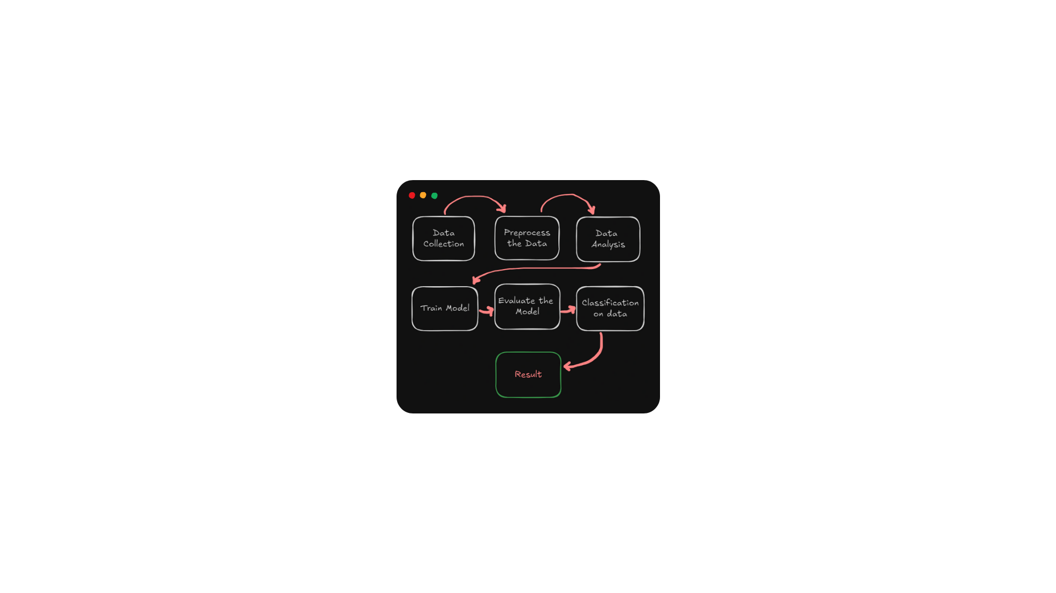
Research Methodology

Slide 6

Data Collection
145,614
LR-HR DDoS 2024
78,733
78,733
Normal Packets
61,881
Malicious Packets
61,881
145,614
Total Packets

Slide 7
Feature Extraction
Hybrid Deep Learning Framework
Classification
Mitigation

Slide 8




Algorithms and Methods
Random Forest
Neural Networks
. Logistic Regression
Hybrid Comparison

Slide 9


Algorithms and Methods
Nature-Inspired
Explainable AI

Slide 10

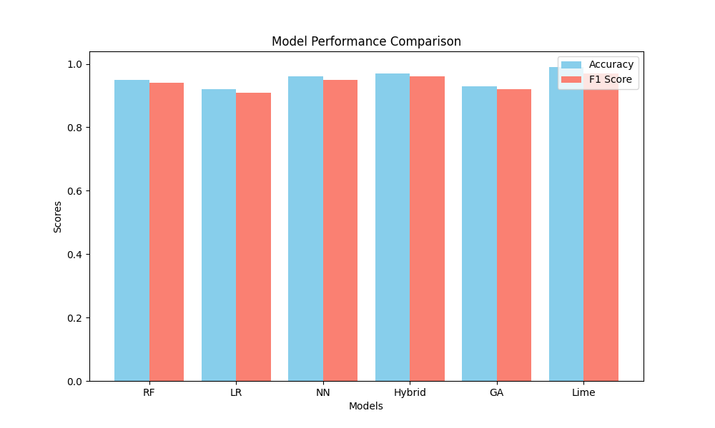
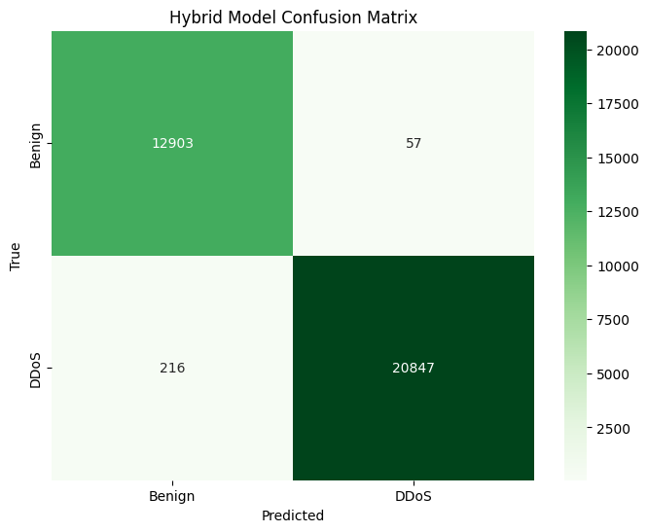
Result And Graphs

Slide 11
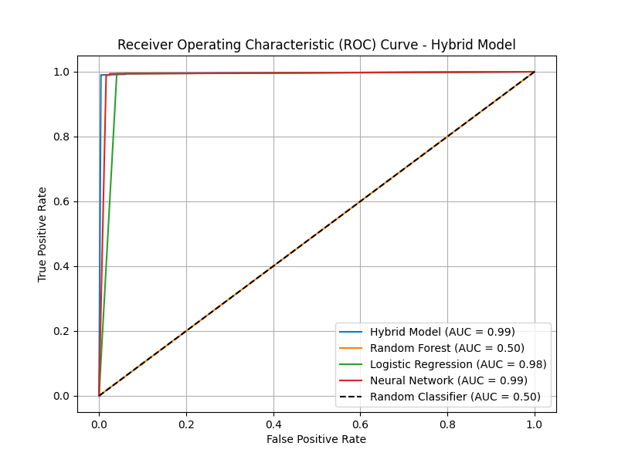
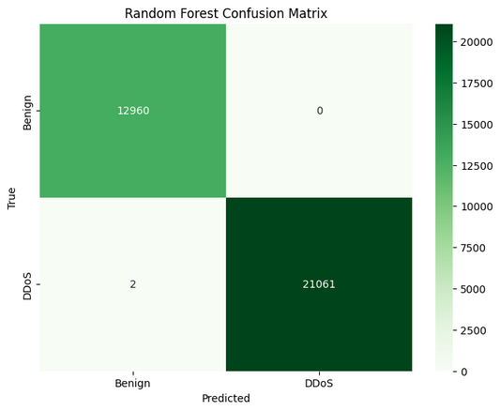

Result And Graphs

Slide 12
Conclusion
Machine Learning Models
Dataset Utilization
Explainable AI
Nature-Inspired Algorithms
Decision-Making Transparency

Slide 13

Future Scope
Real-time classification and data analysis will enable quicker responses to complex cyber threats. Combining traditional and deep learning methods, enhanced with optimization techniques, can create robust detection systems. Future research will focus on trust, SDN integration, and IoT security.

Slide 14


System Requirements

Slide 15
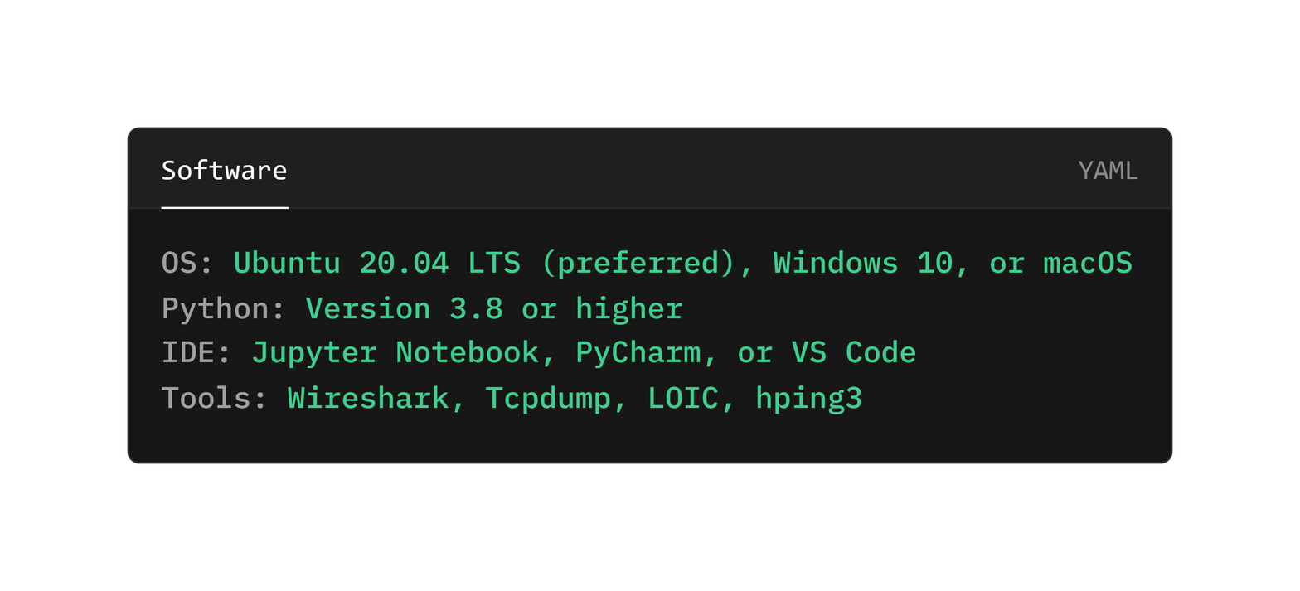
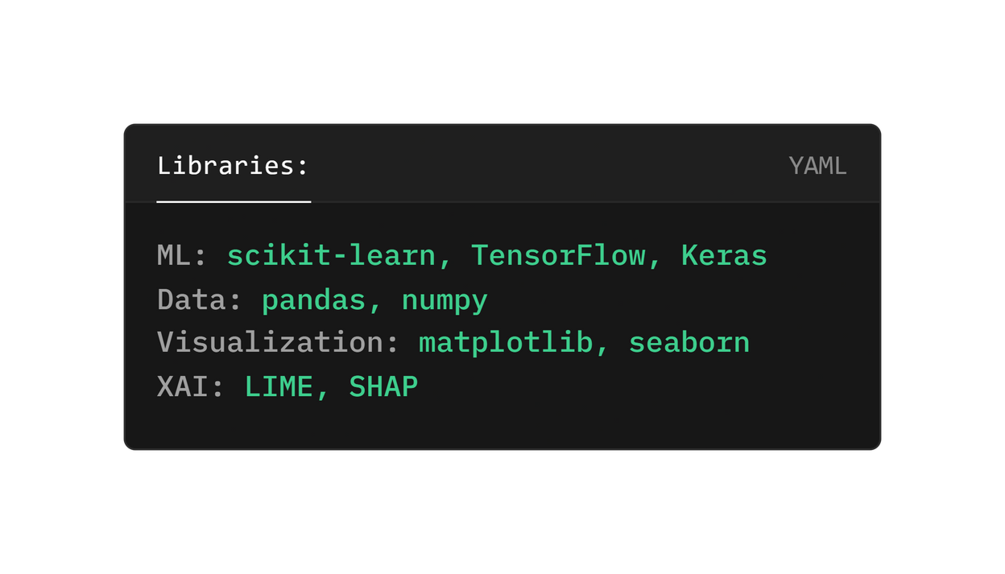
System Requirements

Slide 16

References
  Sahoo, K. S., Panda, S. K., Sahoo, S., Sahoo, B., & Dash, R. (2019). Toward secure software-defined networks against distributed denial of service attack. The Journal of Supercomputing , 75 , 4829-4874.
  Najafimehr, M., Zarifzadeh, S., & Mostafavi, S. (2022) . A hybrid machine learning approach for detecting unprecedented DDoS attacks. The Journal of Supercomputing, 78 (6), 8106-8136. Hariharan, S., Rejimol Robinson, R. R., Prasad, R. R., Thomas, C., & Balakrishnan, N. (2023) . XAI for intrusion detection system: comparing explanations based on global and local scope. Journal of Computer Virology and Hacking Techniques , 19 (2), 217-239.
  Wu, H., & Levinson, D. (2021). The ensemble approach to forecasting: A review and synthesis. Transportation Research Part C: Emerging Technologies , 132, 103357.
  Ahmad, I., Basheri, M., Iqbal, M. J., & Rahim, A. (2018). Performance comparison of support vector machine, random forest, and extreme learning machine for intrusion detection. IEEE access, 6, 33789-33795.
  Bhattacharya, A. (2022) . Applied Machine Learning Explainability Techniques: Make ML models explainable and trustworthy for practical applications using LIME, SHAP, and more . Packt Publishing Ltd.
  Fu, Y., Duan, X., Wang, K., & Li, B. (2022). Low-rate Denial of Service attack detection method based on time-frequency characteristics. Journal of Cloud Computing , 11 (1), 31.
  Wei, Y., Jang-Jaccard, J., Sabrina, F., Singh, A., Xu, W., & Camtepe, S. (2021). Ae-mlp: A hybrid deep learning approach for ddos detection and classification. IEEE Access , 9 , 146810-146821.

Slide 17
References
  Rigatti, S. J. (2017). Random forest. Journal of Insurance Medicine, 47(1), 31-39.
  Parfenov, D., Kuznetsova, L., Yanishevskaya, N., Bolodurina, I., Zhigalov, A., & Legashev, L. (2020, November). Research application of ensemble machine learning methods to the problem of multiclass classification of DDoS attacks identification. In 2020 International Conference Engineering and Telecommunication (En&T) (pp. 1-7). IEEE.
  Razavi, S., & Tolson, B. A. (2011). A new formulation for feedforward neural networks. IEEE Transactions on neural networks, 22(10), 1588-1598.
  Nick, T. G., & Campbell, K. M. (2007). Logistic regression. Topics in biostatistics , 273-301.
  Zhang, M., Zhang, Y., Fu, S., Lv, F., & Tang, J. (2014). Development of a logistic regression formula for evaluation of subcentimeter thyroid nodules. Journal of Ultrasound in Medicine, 33(6), 1023-1030.
  Aamir, M., & Zaidi, S. M. A. (2019) . DDoS attack detection with feature engineering and machine learning: the framework and performance evaluation. International Journal of Information Security , 18 , 761-785
  Azevedo, B. F., Rocha, A. M. A., & Pereira, A. I. (2024). Hybrid approaches to optimization and machine learning methods: a systematic literature review. Machine Learning, 1-43.
  Wirsansky, E. (2020). Hands-on genetic algorithms with Python: applying genetic algorithms to solve real-world deep learning and artificial intelligence problems. Packt Publishing Ltd.
  Pedersen, T. L., & Benesty, M. (2018). lime: Local interpretable model-agnostic explanations. R package version 0.4 , 1

Slide 18

Thank You!

